Slide 1

SPEECH RECOGNITION
- Rajalakshmi Santhakumar
DS-SEA 08

Slide 2
RECAP
Project question:
Can we build a model that can transcribe, with accuracy, the spoken words (in English) to text?
Data Source:
Google Speech Commands Dataset - Contains a set of one-second .wav audio files, each containing a single spoken English word, collected by crowd sourcing
Twenty core command words and ten auxiliary words

Slide 3
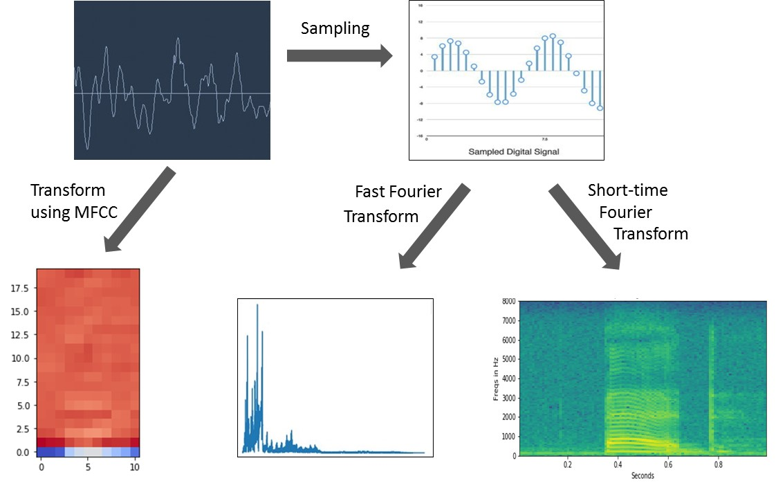
DATA PRE-PROCESSING

Slide 4
DATA PRE-PROCESSING (continued..)
SAMPLING AND FAST FOURIER TRANSFORMATION (FFT)
Sampling - reduction of a continuous-time signal to a discrete-time signal
FFT - breaks complex sound wave into its component parts -provides a score that represents energy in each 50 Hz band of the audio clip
SAMPLING AND SHORT-TIME FOURIER TRANSFORM (STFT)
Spectrograms are visual representations of the spectrum of frequencies of sound
Obtained by using short-time Fourier transformation of the digitally sampled signals.
MEL-FREQUENCY CEPSTRAL COEFFICIENTS (MFCC) TRANSFORMATION
Derived by taking Fourier transform of a signal, mapped to the powers of the spectrum onto the mel scale (a perceptual scale of pitches),followed by taking the logs of the powers at each of the mel frequencies and then, the discrete cosine transform.
Amplitudes of the resulting spectrum represent the MFC coefficients.

Slide 5
DATA PRE-PROCESSING (continued..)
‘mfcc’ from ‘librosa’ package – yields an 11 x 20 / 11 x 13 matrix for each audio file
Matrices corresponding to the same word (for instance, ‘bed’) are appended together and stored in a numpy file
 | Features | Sampling And Fast Fourier Transformation | Sampling And Short-Time Fourier Transform | MFCC Transformation
1. | Size of preprocessed data for each audio file | 1 x 16000 1 x 8000 | 99 x 160 | 11 x 20 11 x 13
2. | Time taken for processing 1000 files | ~12 minutes | ~4-5 minutes | <1 minute
3. | Extent of data preprocessing (as seen by neural network models) | Moderately preprocessed | Moderately preprocessed | Highly preprocessed

Slide 6
DATA MODELING
5 randomly selected words used for modeling -‘bed’, ‘cat’, ‘happy’, ‘yes’ and ‘no’
MFCC coefficients -feature matrix, X; words – response vector, y
Train-test set split – 6991 : 4662
Convolutional 2D Neural Network - Sequential CNN using the package ‘keras’ with ‘Theano’ backend with input shape to (20, 11, 1) / (13, 11, 1)
ReLU Dense layer represents the number of Rectified Linear Units which increases the nonlinear properties of the overall network (usually in the powers of 2)
Softmax Dense is the generalization of the logistic function which represents the number of classes (here, the number of words)
Model was compiled with function to minimize the categorical crossentropy losses and the accuracy was measured
Model was run in a batch size of 100 with epoch (number of iterations) value of 50

Slide 7
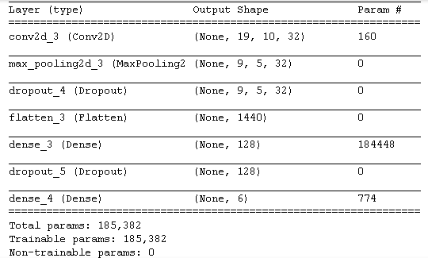
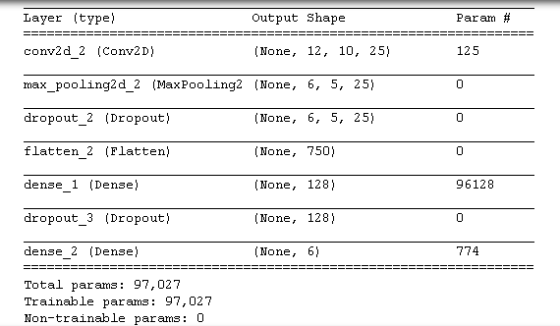
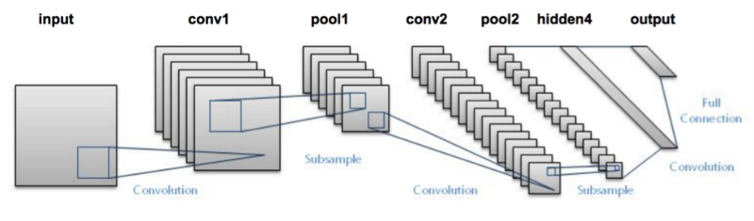
MODEL SUMMARY
Input shape: (20,11,1)
Input shape: (13,11,1)

Slide 8
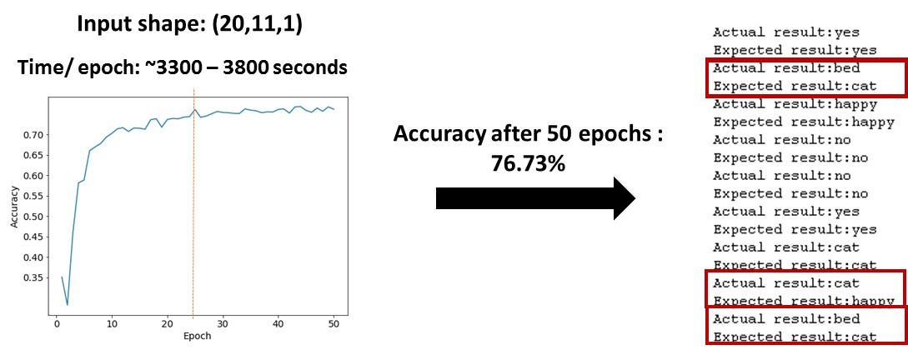
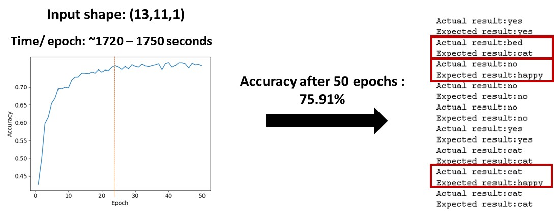
MODEL EVALUATION AND PREDICTION

Slide 9
CONCLUSION AND FUTURE DIRECTIONS
CONCLUSION
Accuracy improves with the number of iterations up to ~25 epochs, after which the graph reaches a plateau - optimal value for epoch is ~25.
FUTURE DIRECTIONS
Finding an optimal number of MFCC matrix dimension to tradeoff between accuracy score and time taken.
Using Spark or other multi-threading options and repeating the analysis on the entire dataset to check the robustness of the model.
INPUT SHAPE | ACCURACY
(20, 11, 1) | 76.73%
(13, 11, 1) | 75.91%

